Slide 1
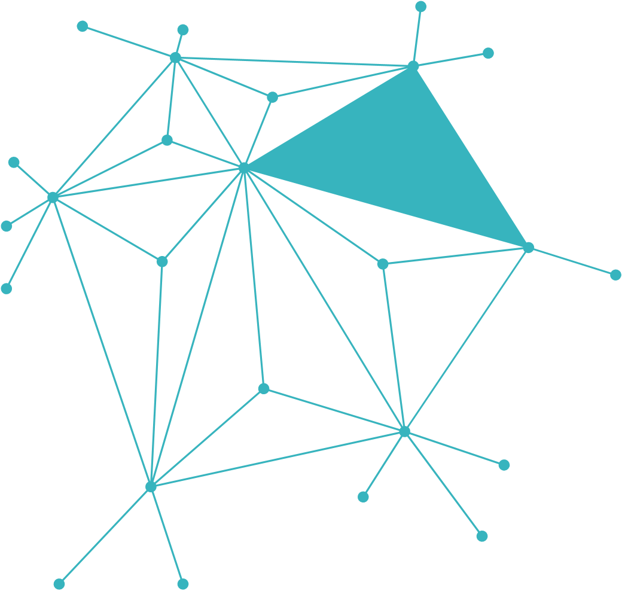
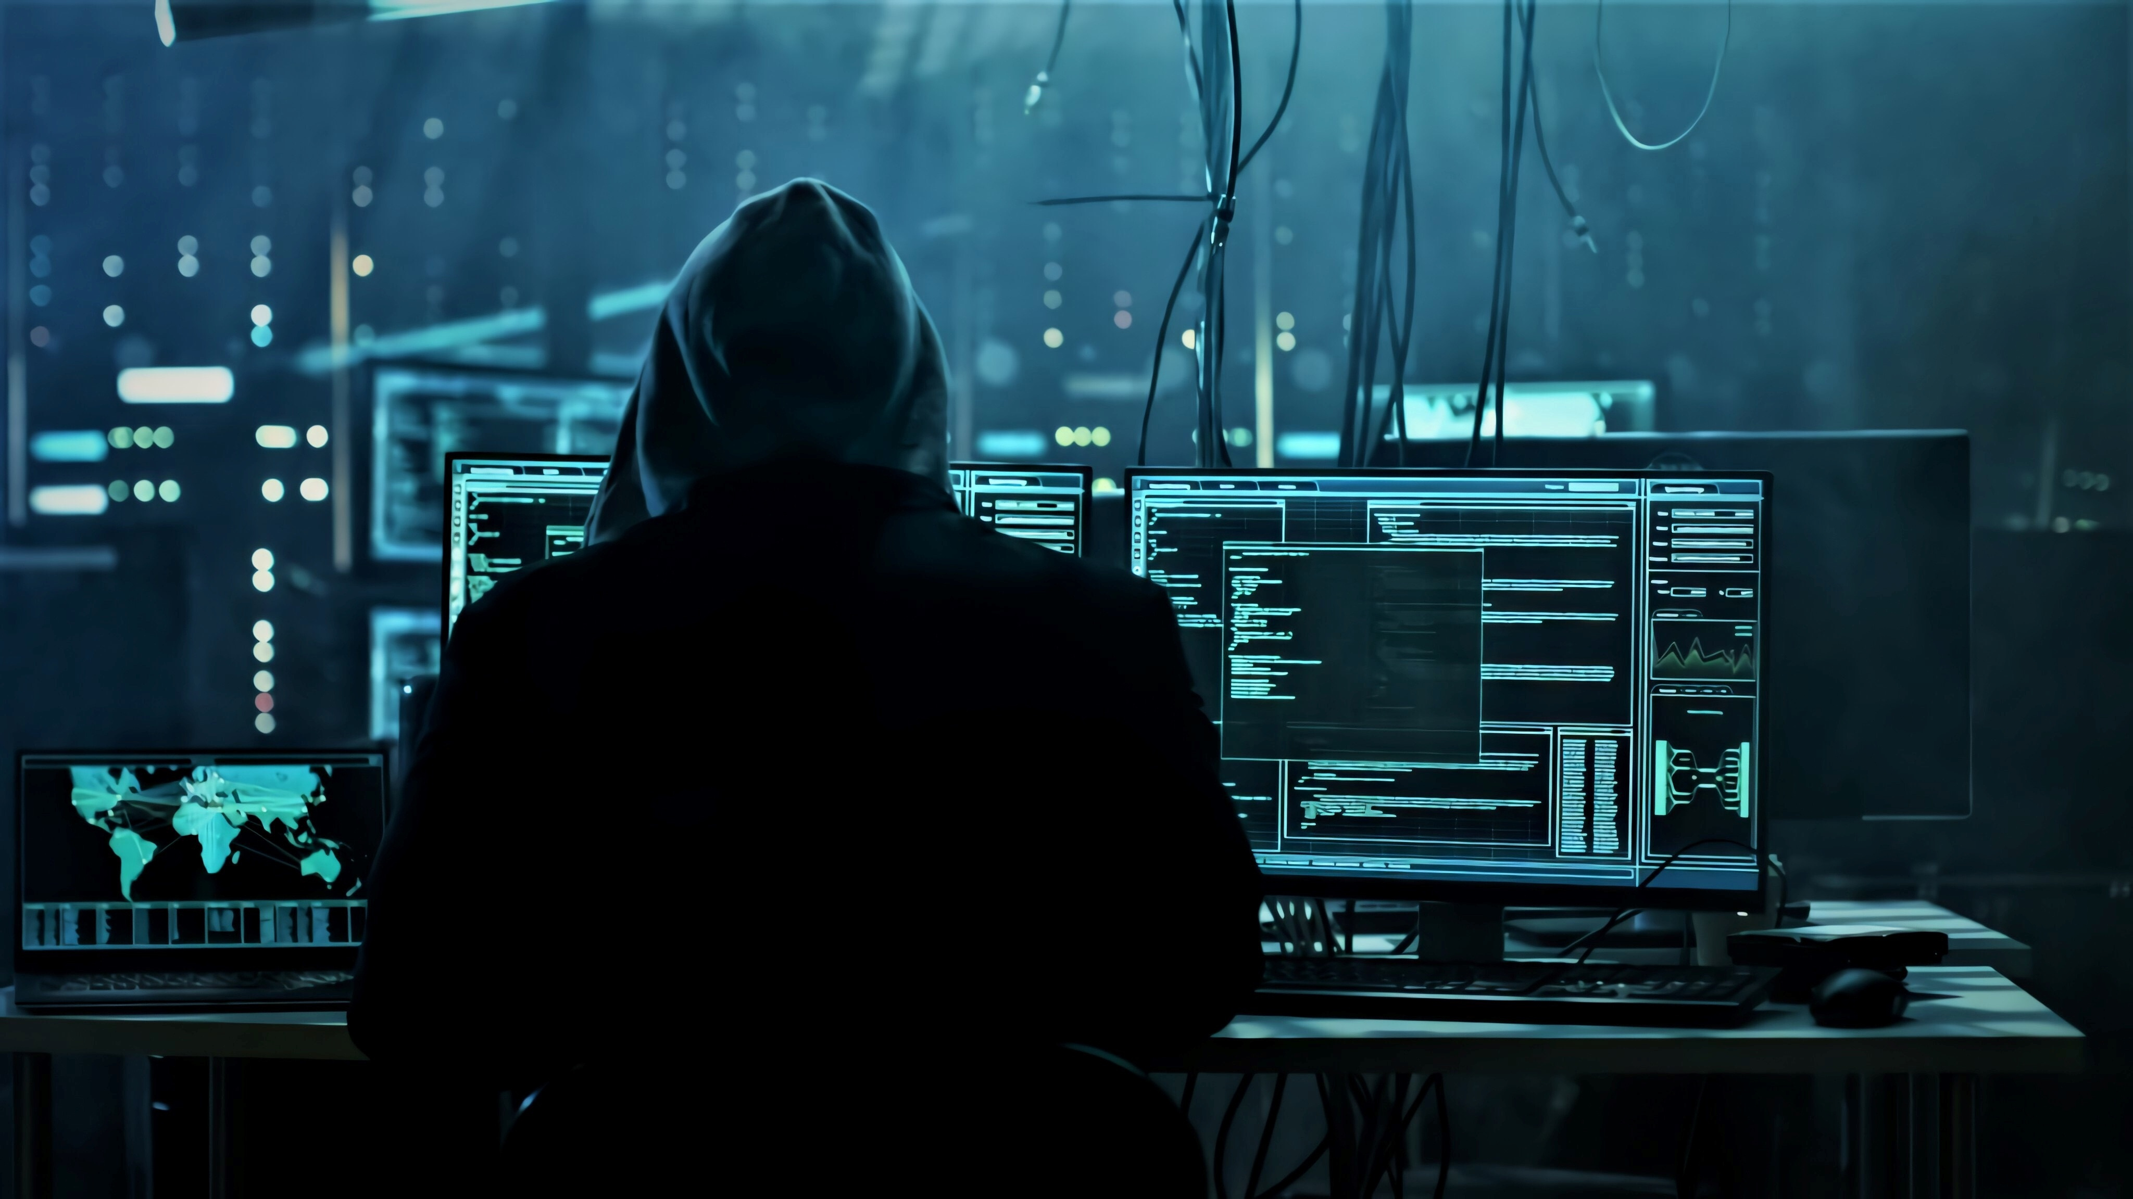
CYBER BRIDGE
Open Source Cyber Security Toolkit For Teachers

Slide 2

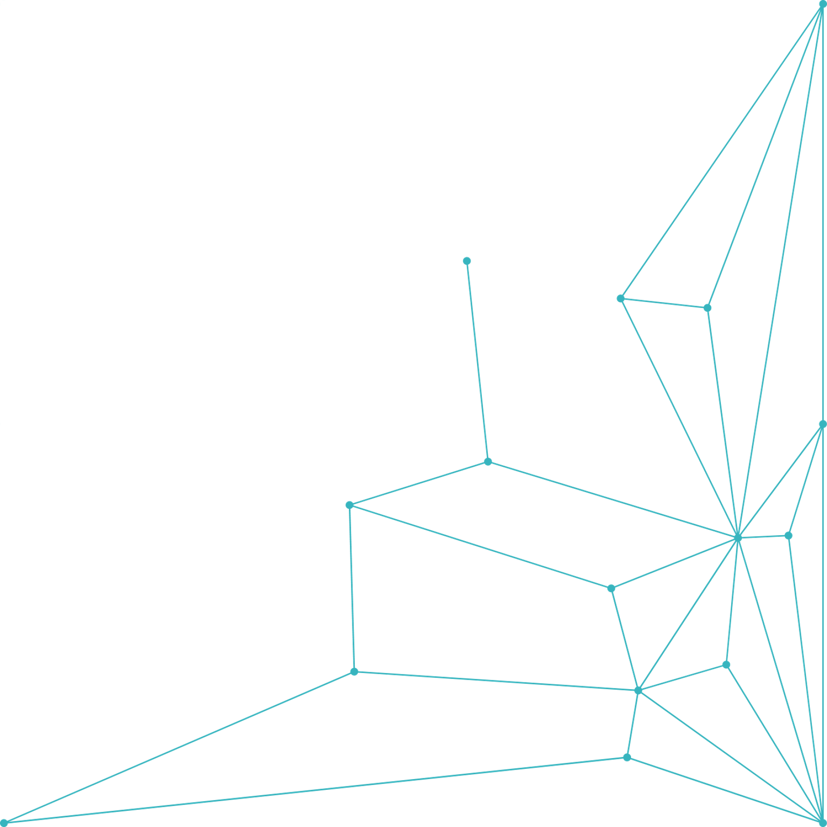
INTRODUCTION
This is a great first step in building students awareness of cybersecurity
This lesson highlights the importance of password security.
LESSON ONE
LEARNING OBJECTIVES
Understand why password security matters in everyday digital life
Teach Students how to create and manage strong passwords.
Get Introduced the use of password managers like Bit warden.
PASSWORD SECURITY AND AUNTHENTICATION

Slide 3

Passwords are the first line of defense against unauthorized access to personal data.
Real-world breaches:
LinkedIn (2012): LinkedIn, with 165 million users in 2012, stored professional details like resumes, connections, and private messages (e.g., job offers). The breach exposed 117 million email addresses and hashed passwords, initially thought to be only 6.5 million. Hackers could access accounts, alter profiles, or send fraudulent messages, damaging users’ careers and reputations.
PASSWORDS
***Weak passwords make accounts easy to hack.
DISCUSSION: Ask students what could happen if someone got into their school email or Instagram or Facebook accounts(social media accounts).

Slide 4
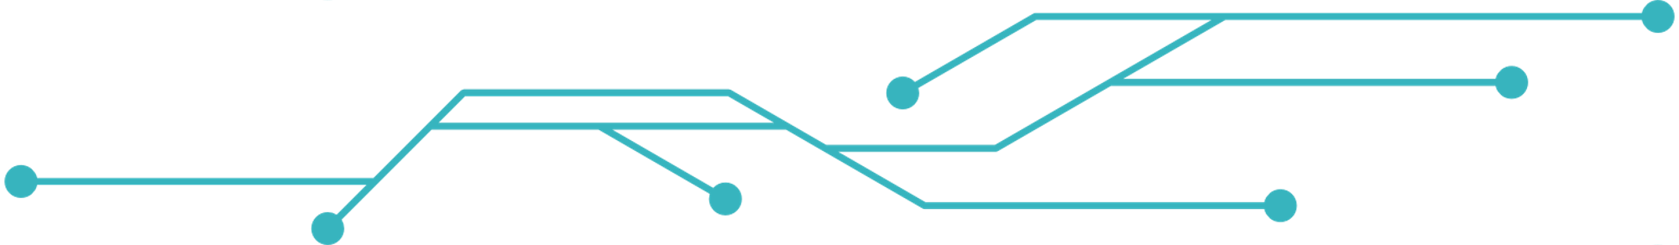

COMMON WEAK PASSWORDS
123456
password
john2005
Mydog123
**These passwords are easy to guess
WHAT MAKES A STRONG PASSWORD?
At least 12 characters long
Includes uppercase and lowercase letters
Use numbers and symbols
Avoid personal info (e.g., names, birthdays)
Use passphrases: Combine unrelated words.
EXAMPLES OF STRONG PASSWORDS; Ocean!Wave37%, CoffeeTime@8am, BananaCactus!47River

Slide 5
INTRODUCTION TO BITWARDEN
Bitwarden is a free password manager, a secure open source password manager that:
Stores and manages passwords safely
Generates strong passwords
Sync your passwords across multiple devices
Best Password Manager for Business, Enterprise & Personal | Bitwarden
Access the Guide : https://bitwarden.com/help/get-started-individual-user/
For a visual walkthrough : https://youtu.be/OkYKb0Sx-XA?si=2ZOb68rkOZXojlHY
Interactive Group Activity: Password Analyzer
Form small groups of 3–4 students
Task: Create three passwords as a team
Exchange and evaluate each other's passwords using a scoring sheet (1–5)
Discuss what made some passwords stronger than others

Slide 6

QUIZ OR ONLINE GAME
Check through google form in quizzes section
Sample Questions:
- Identify the strongest password
- Spot the vulnerability in a password
- Understand why password reuse is risky
WRAP UP
Recap:
- Passwords protect personal data
- Strong passwords are complex, long, and unique
Homework:
- Ask a family member how they remember their passwords
- Reflect: How safe are your own passwords?

